Slide 1
Life Expectancy: What and Why?
Group 9: Fangchen Wang, Emma Zurstrassen, Jason Huang, Aneeka Agarwal, Vanshika Bhatia, Alberic Teisseire

Slide 2
Data Source
Gapminder dataset
World Bank’s health nutrition and population statistics
The world bank’s life expectancy dataset

Slide 3
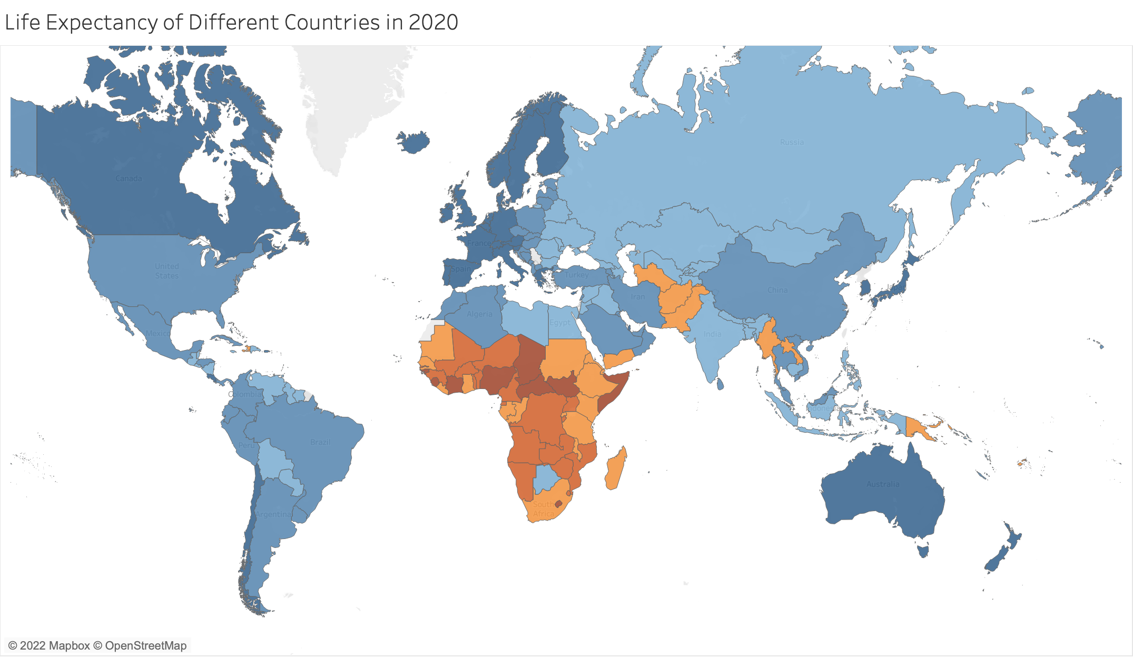
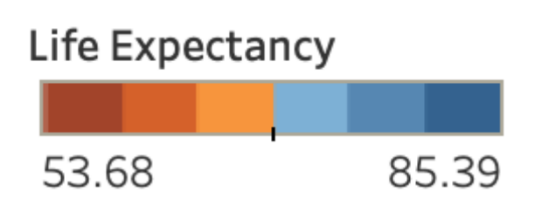
There is a clear difference in life expectancy around the globe, with Europe and North America higher than the rest of the world, and Africa lower than average.

Slide 4
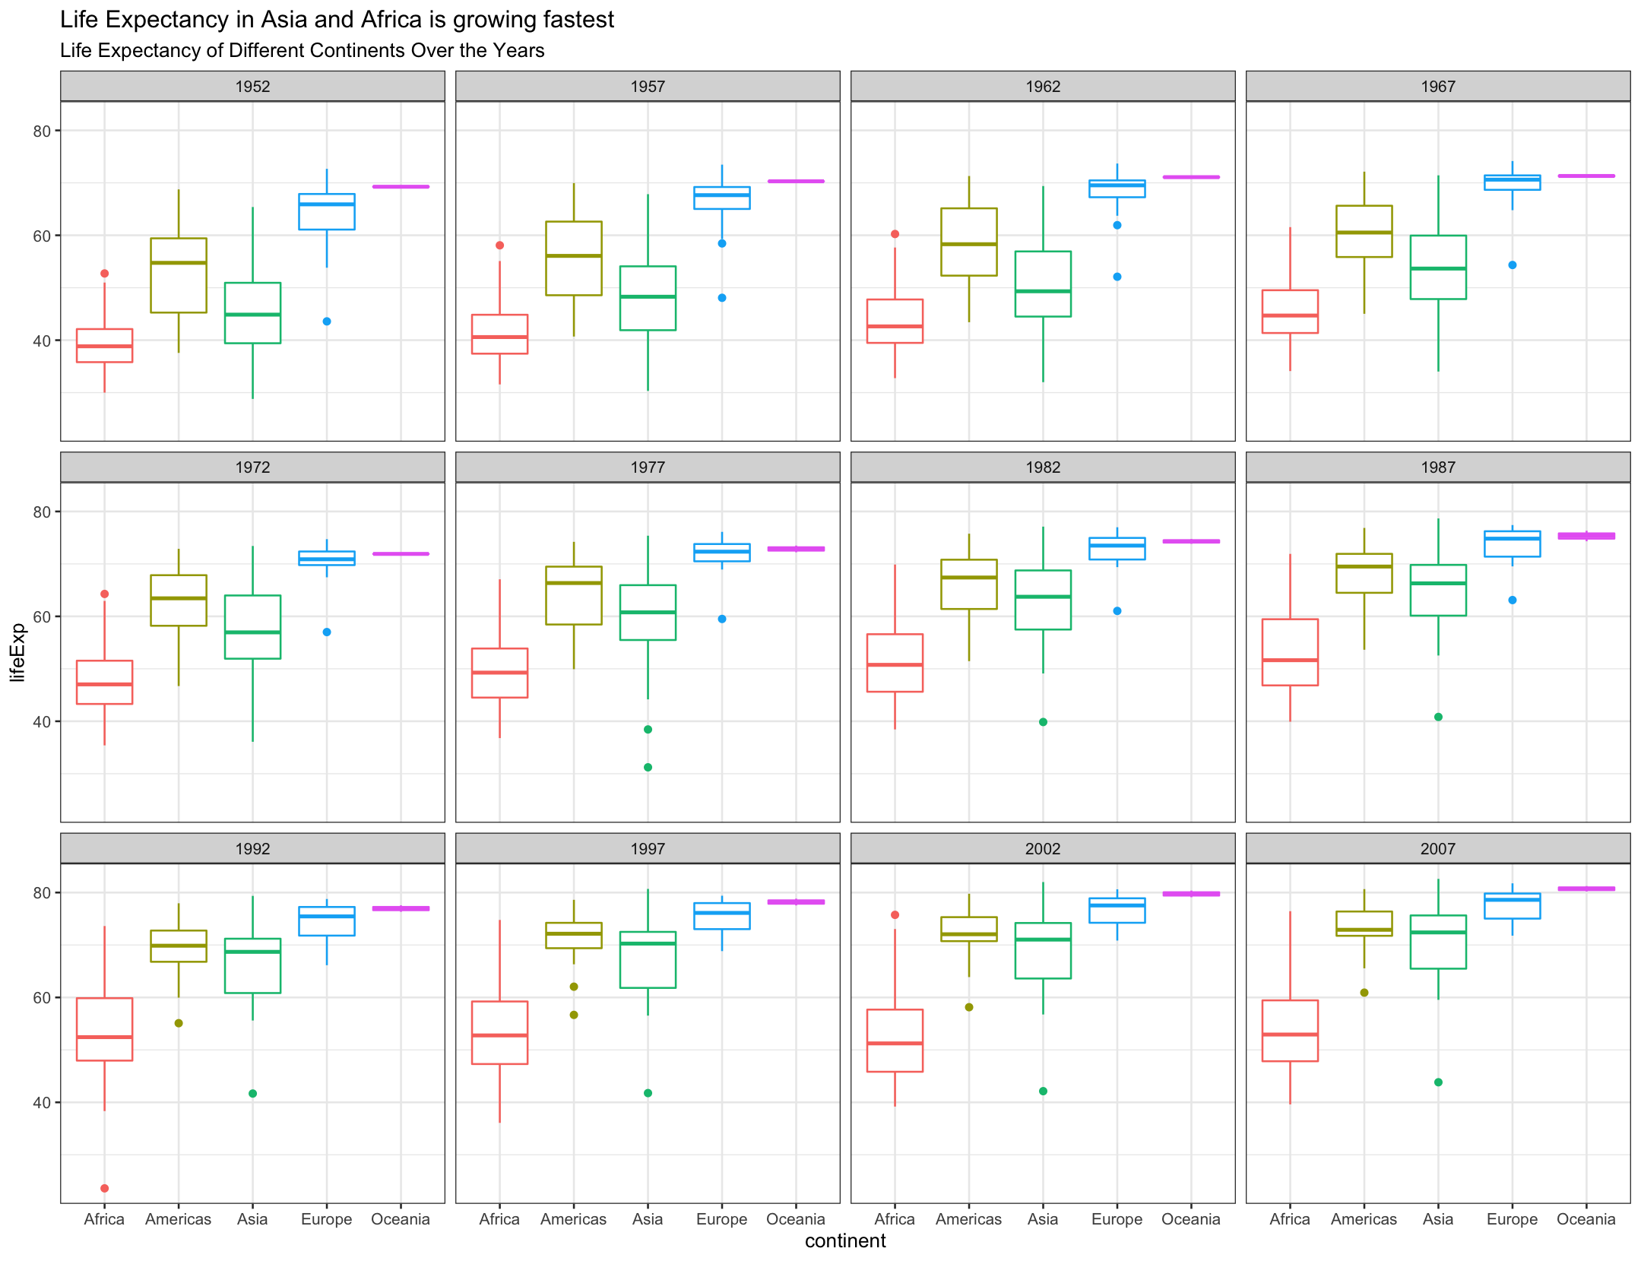

Slide 5
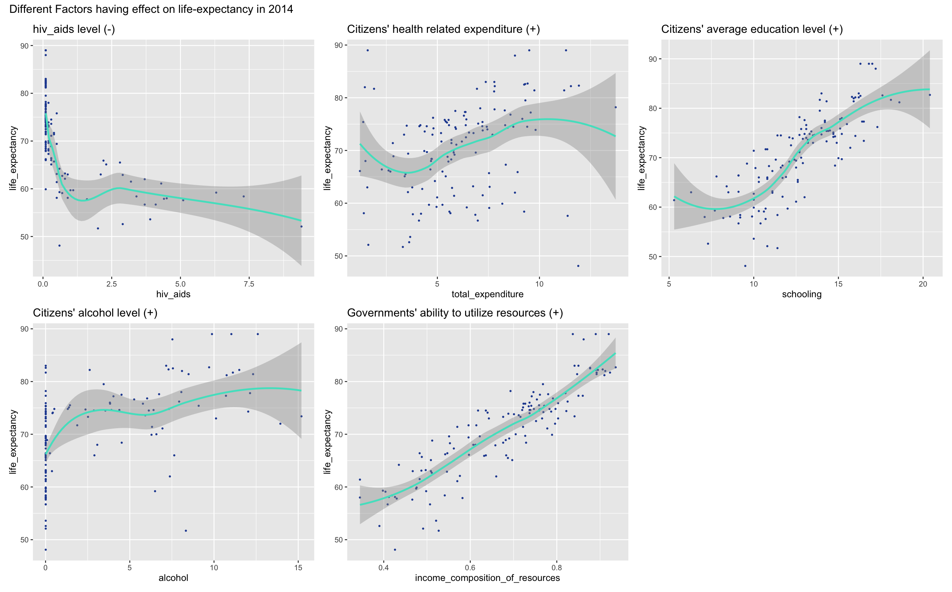

Slide 6
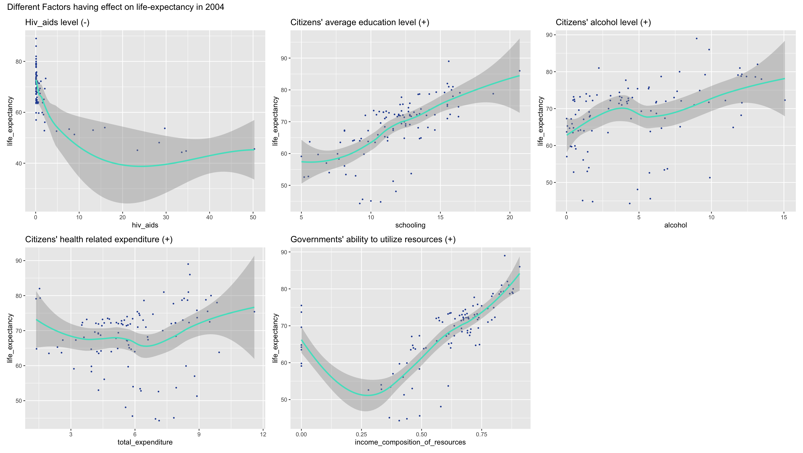

Slide 7
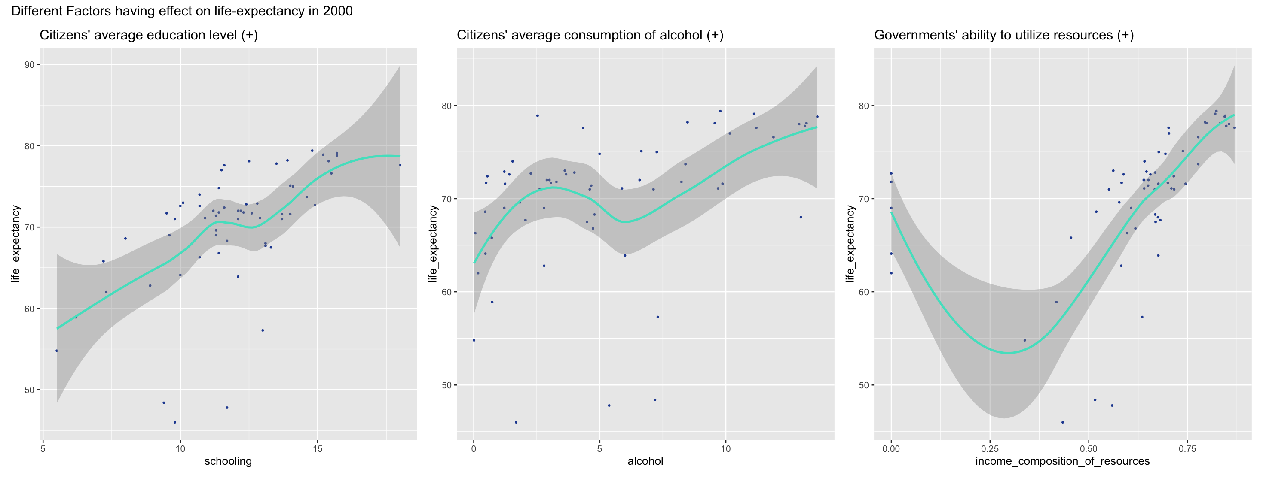

Slide 8
